Slide 1


Practical Statistics
Turning statistics into a toolkit for ecologists

Slide 2




Intro
Henry Häkkinen
Post-Doc studying the effects of climate change on seabirds and how to plan effective conservation. Latterly branched out into impacts of renewable energy on biodiversity.

Slide 3
Optional: Bayesian Statistics
Overview of session:
What is “Bayesian” statistics?
Bayesian versus Frequentist statistics
Bayes’ Theorem
Priors
Running an interative model
Posterior distribution
Interpreting output
Major differences between frequentist and Bayesian model

Slide 4
Cut?: What are statistics?
The collection, organization, analysis, interpretation, and presentation of data
In science, we often use “statistics” as short-hand for “inferential statistics” which examines properties of data in relation to underlying probability distributions
This includes hypothesis testing! And most forms of classical models!
Alternatives include “descriptive statistics” which we use all the time (mean, median, standard deviation etc.)

Slide 5
What is a “Bayesian” approach?
An alternative type of statistical inference than that of frequentist statistics.
https://esajournals.onlinelibrary.wiley.com/doi/10.1890/14-0661.1
https://tobiasroth.github.io/BDAEcology/basics.html
https://besjournals.onlinelibrary.wiley.com/doi/10.1111/2041-210X.13407

Slide 6
Wait, what are frequentist statistics?
Probably most, if not all, statistical tests you have done up until this point:
T-tests, linear models, GLMs, GLMMs etc.
Quick test: if it has a p-value it’s probably frequentist
In a frequentist approach we assume there is an overall global distribution, from which our data are just samples
E.g. normal, binomial, Poisson etc.
Frequentist statistics assess:
Whether the data fits our assumed distribution
Whether our data differs from a “null” distribution for hypothesis testing

Slide 7
Side note:
Broadly speaking there are four branches of statistical inference you are likely to come across
Inferential Statistics
Frequentist Statistics
Bayesian Statistics
Likelihood
Information Criteria
Common uses:
Maximum Likelihood Estimation
Likelihood-ratio tests (model comparison)
Common uses:
Aikake Information Criterion (AIC)
Relative model quality and model selection
Some approaches combine these!

Slide 8
What is a “Bayesian” approach?

Slide 9
Which approach should I use?
Both are valid approaches for almost every statistical question, they just work differently
You are run a linear regression using a frequentist or Bayesian approach and they will likely give the same answer.
Advantages of Frequentist approach:
Generally faster, especially for simpler models
Still standard approach in ecology so better tutorials and support
Larger array of tools and packages to solve standard problems, little customisation needed
Results are (often) more interpretable, with single estimates
Advantages of Bayesian approach:
Generally better at modelling complex systems, especially with small sample sizes
Much more powerful and flexible, can solve statistical problems that frequentist approaches cannot
Credible intervals are usually more robust, generally give a more intuitive sense of uncertainty

Slide 10
Part 1: The Basics of Bayes

Slide 11
Bayes’ Theorem

Slide 12
Bayesian Statistics
Here’s a famous case study
“The serum test screens pregnant women for babies with Down’s syndrome. The test is a very good one, but not perfect. Roughly 1% of babies have Down’s syndrome. If the baby has Down’s syndrome, there is a 90% chance that the result will be positive. If the baby is unaffected, there is still a 1% chance that the result will be positive. A pregnant woman has been tested and the result is positive.”
What is the chance that her baby actually has Down’s syndrome?
48%! This is non-intuitive, but the knowledge of the general probability of prevalence has revealed some interesting information!
Priors make modelling faster as it only trials the parameter estimates we tell it to. They also rule out physically impossible, but mathematically valid, answers. They also can account for uncertainty in observations

Slide 13
Bayesian Statistics
Bayesian statistics use a different approach. There is no null model, there are no p-values, and no residuals (sort of). There is no theoretical “ideal” distribution. Instead, the data is considered to be “reality” and we just see how well we can describe it mathematically.
Bayesian statistics rely heavily on priors. This is information we provide to the model about what we think reality is like
This reliance on “Bayes theorem” is critical. We tell the model what we think reality is like, and then the model find parameters to describe it.
This may seem odd, and subjective, but it is more important and appropriate than you think

Slide 14
Priors

Slide 15
Part 2: running a basic Bayesian model

Slide 16

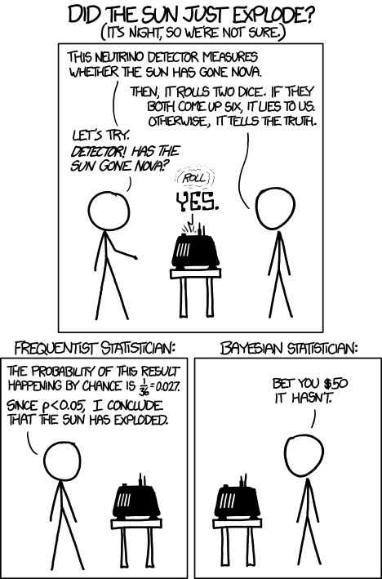
Bayesian Statistics
The basic process for making a Bayesian model works like this:
define the model
define the priors
run the model
check model ran properly (convergence, fuzzy caterpillars etc)
check parameter output
make conclusions and plots
https://xkcd.com/1132/

Slide 17
Define the model

Slide 18
Define the priors

Slide 19
Build and run the model

Slide 20
Model convergence

Slide 21
Model output

Slide 22
Making conclusions

Slide 23
Part 3: Practical advice

Slide 24
Differences between Frequentist and Bayesian: part 2

Slide 25
The Bayesian Approach: When do I use it?
If it makes sense for your data (heavy conditional probabilities)
If standard frequentist methods don’t work
Lots of random effects?
Highly hierarchical data?
No standard distributions work?
Other problems that can’t be modelled easily in a frequentist approach (e.g. heteroskedasticity)?
If the model you wish to build has too much complexity for the sample size. Bayesian approaches can compensate for small sample sizes to some extent, especially for categories, interactions and other terms that require a large number of degrees of freedom in a frequentist approach
If you like the Bayesian approach and have a lot of time on your hands!
Makes you specify your model and really understand your data
Also takes time and experience to run them!

Slide 27
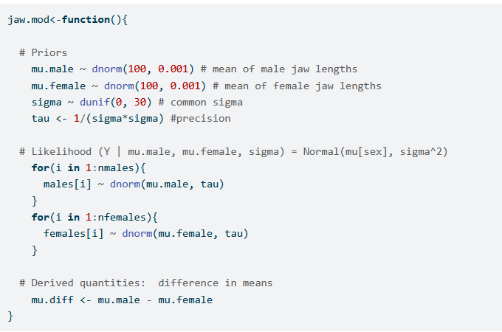
The Bayesian Approach: Example
We are going to compare jaw length in male and female jackals.
This is a normal distribution, that may vary between two categories (male and female)
As it’s a normal distribution it only has two parameters, the mean and the standard deviation
We set the priors to be specific, but with some flexibility to change
Here’s the model:

Slide 28
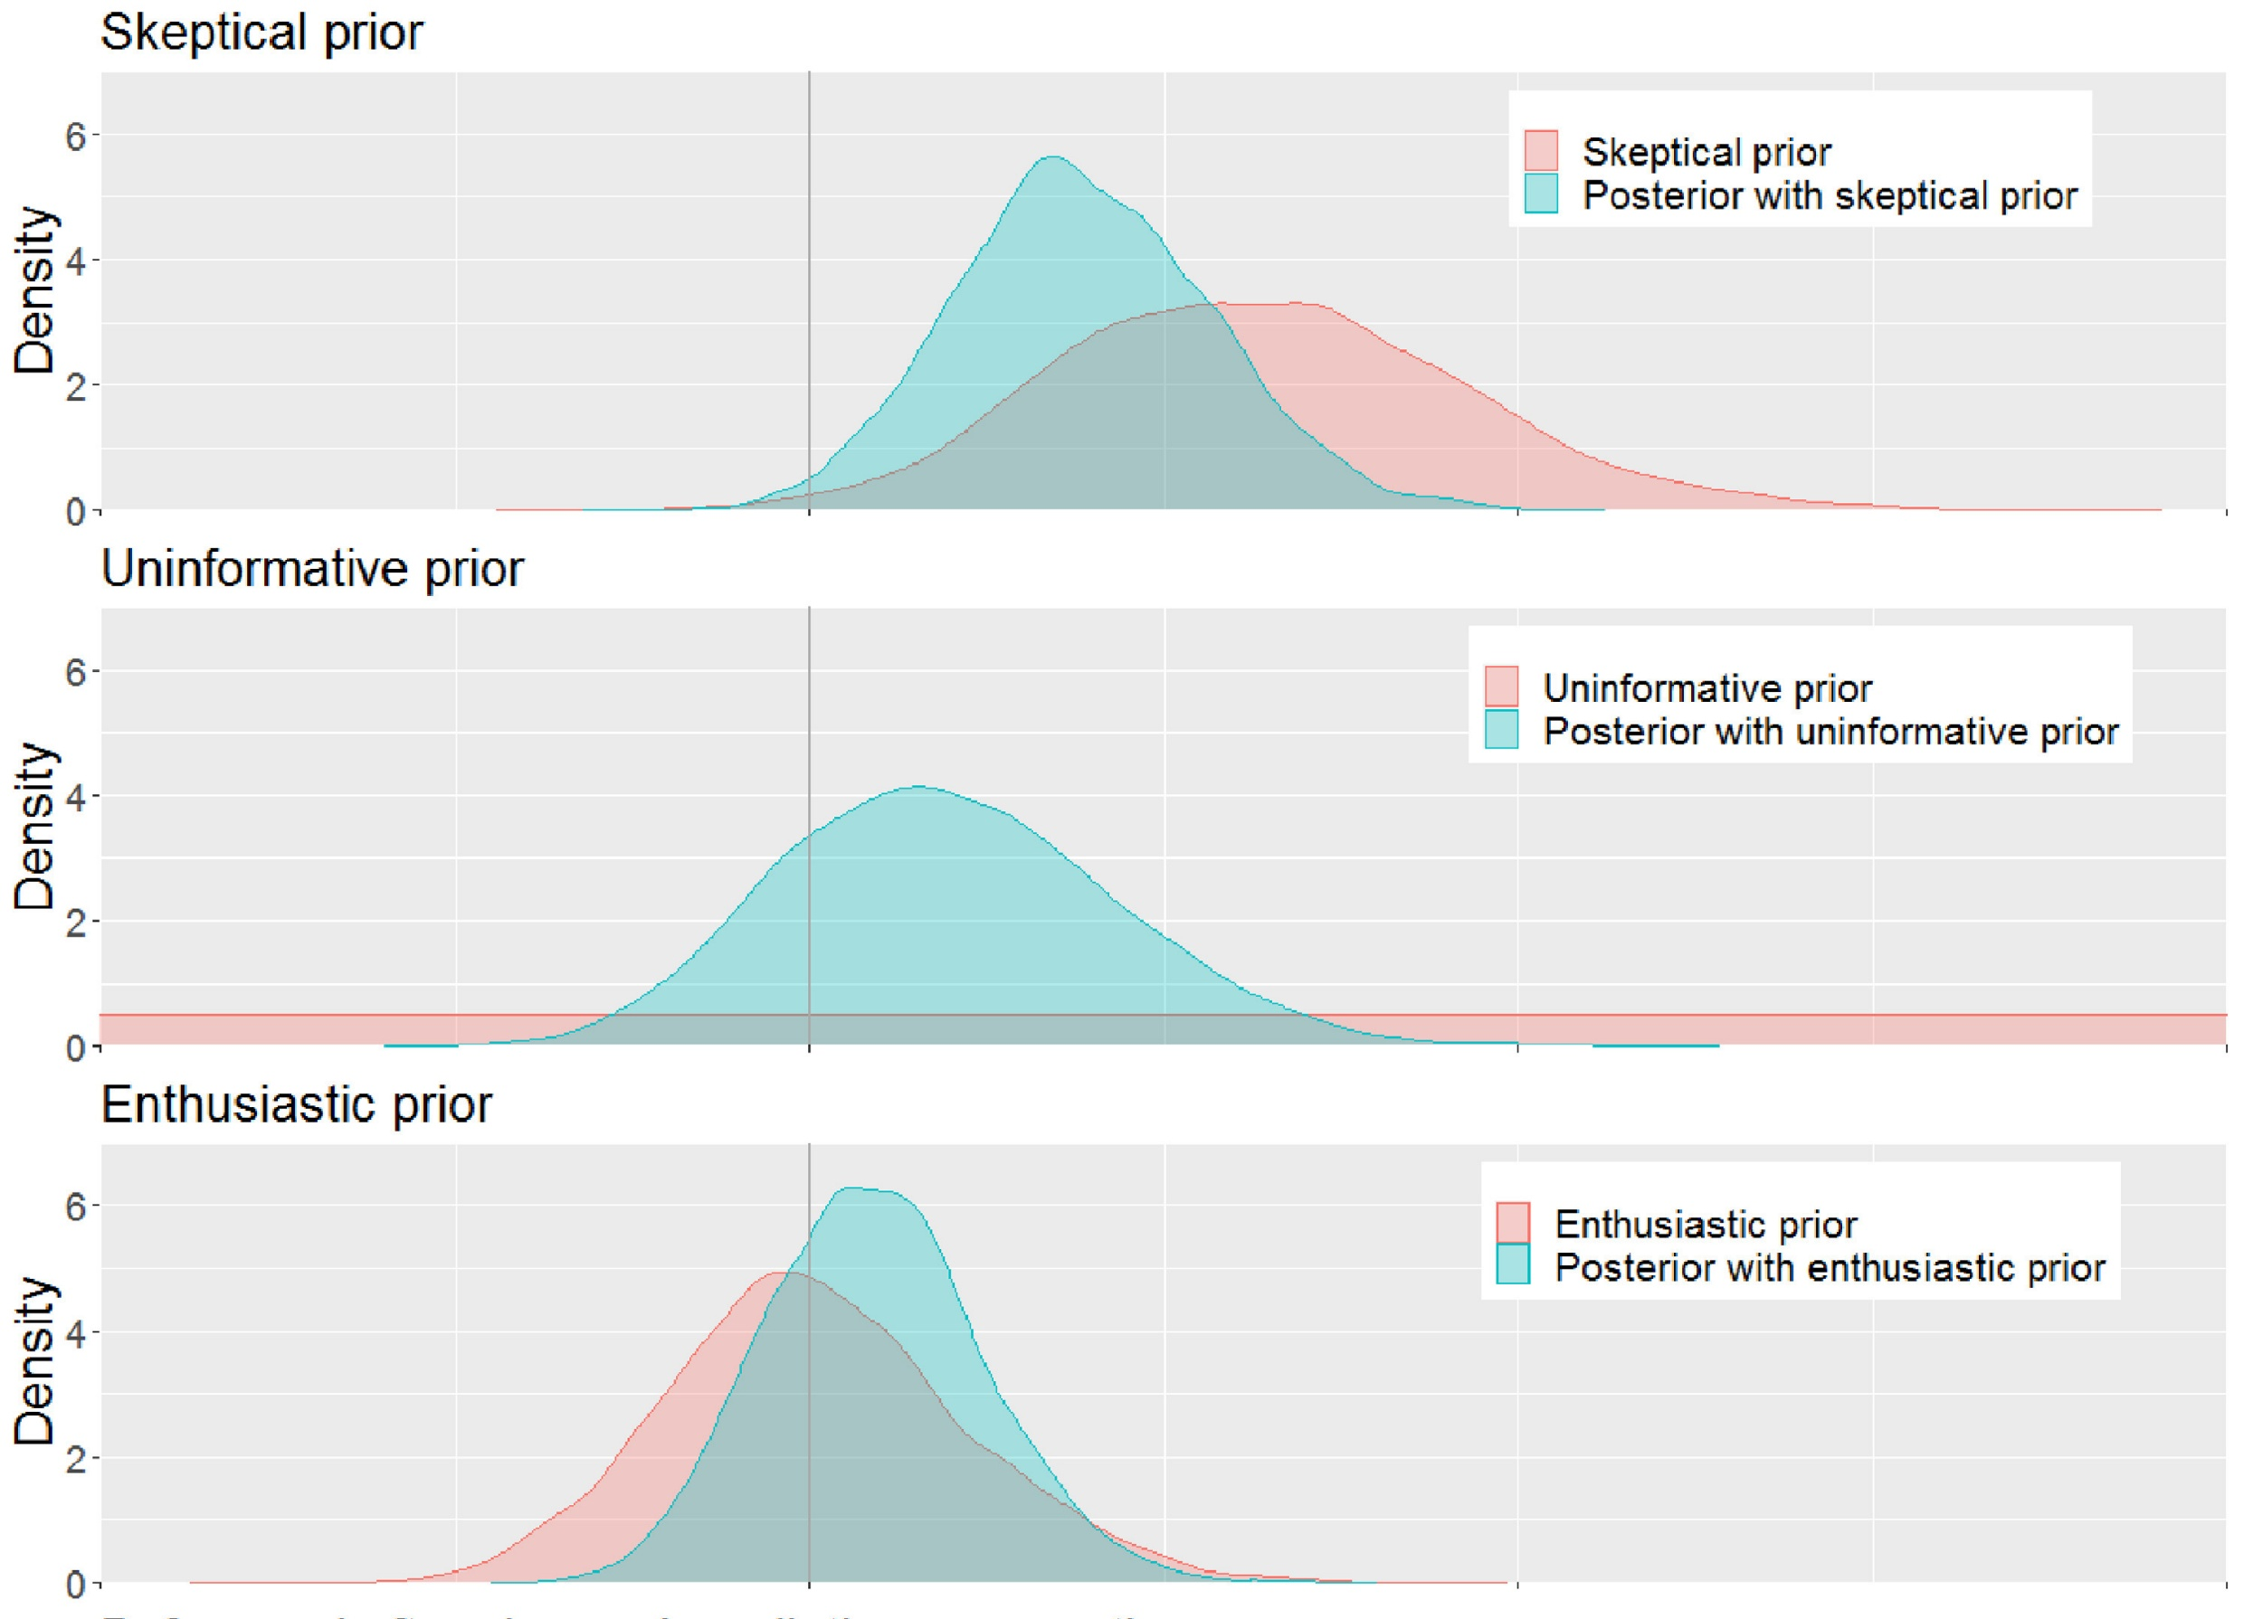
The Bayesian Approach: Example
It is up to us on how restrictive or flexible the priors are
Many are tempted to use an “uninformative” prior, but these often bias models AND make them harder to converge.
https://www.redjournal.org/article/S0360-3016%2821%2903256-9/fulltext

Slide 29
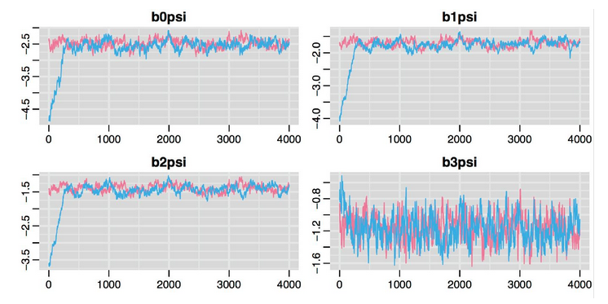
The Bayesian Approach: Example
We run the model and make sure it’s converged. The model will iterate across the parameter space and try out all (or nearly all) possible solutions.
It should resolve to the most likely solutions. This consistency is called “convergence”.
We can check for it by looking for “fuzzy caterpillars”

Slide 30
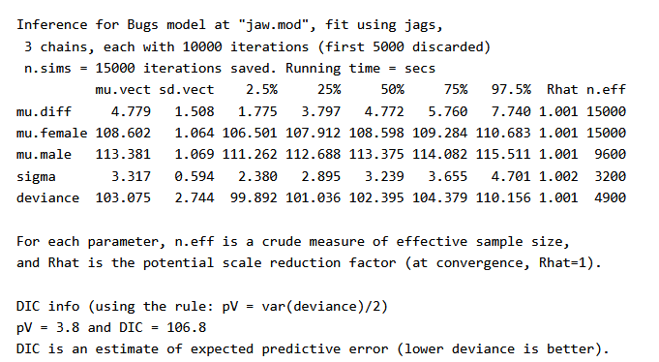
The Bayesian Approach: Example
The output of a Bayesian model will tell us where the parameters are by the end
This output is known as the “posterior” distribution
These are equivalent to parameter estimates in normal GLMs, but intrinsically come with credible intervals.

Slide 31
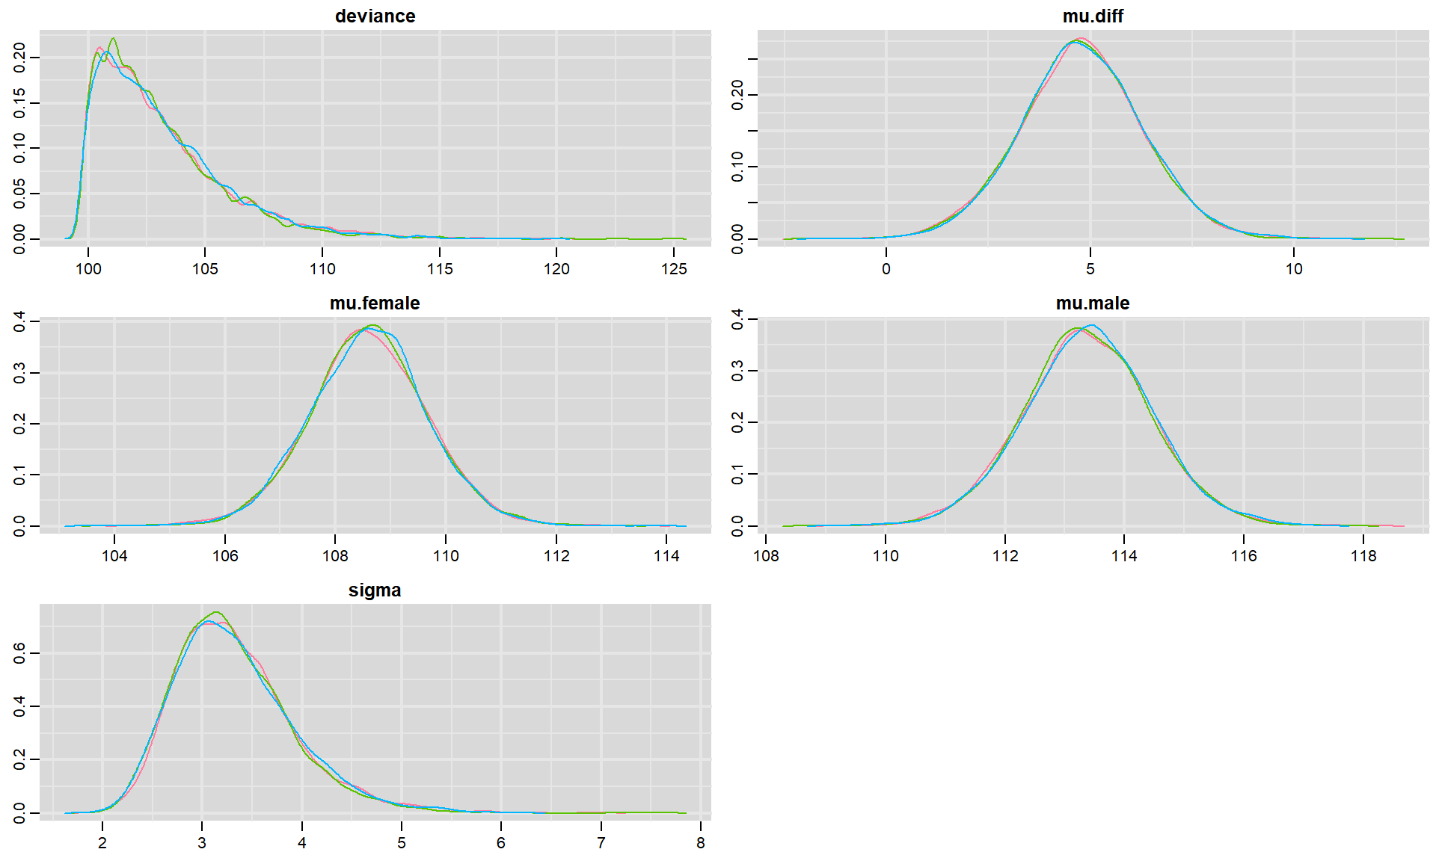
The Bayesian Approach: Example
We can look at these estimates as distributions. Where is the mean estimate, how certain is the model that this is the “real” estimate?

Slide 32
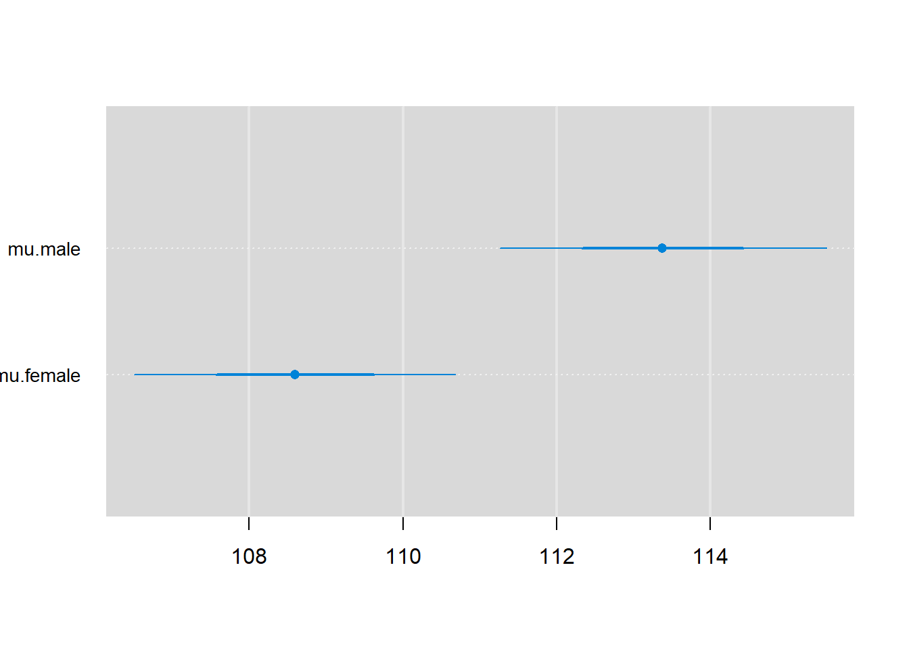
The Bayesian Approach: Example
We use credible intervals to check whether there is any overlaps or substantial differences. For example, is there any overlap in average female and average male jaw size at 90% CI?

Slide 33
Part 4: Exercises

